Slide 1
Distance-based Clustering of Sparsely Observed Functional data, with an application to online auction data
Daisy Yu
Simon Fraser University
Feb 25, 2019
Notes:
So today I’m going to introduce a another clustering methods for functional data that based on specific distances between objects, and this method is particularly proposed for data which are sparsely and irregularly observed during a certain time interval.
Such data occur commonly in longitudinal studies and online trading data, so I will present this method with a specific application on online auction data.

Slide 2
Outline
Introduction
Method
Application
Summary
Notes:
First, just a little background and introduction of this topic. What is the motivation and how this method is derived from a real life problem.
Second, I will go through the method and talk about the application. Then I will show you how our results gives some interesting insights to the problem that we want to solve from the very beginning. Finally, I will do a short summary.

Slide 3
Functional data clustering
The goal of clustering analysis is to group a collection of subjects into clusters.
A measure of similarity/dissimilarity between subjects is a necessary ingredient for distance-based clustering.
Finding a suitable distance measure for irregularly and sparsely observed longitudinal data can be a challenge.
i.e. the online auction data
Notes:
So functional data clustering is a type of unsupervised learning on functional data which aims to group a collection of subjects into clusters each with a corresponding pattern. In distance-based clustering, it is important to obtain a distance matrix and each element in this distance matrix is a measurements of similarity/dissimilarity between each pair of objects within the data. In most cases, we just simply use the distance between two objects as a measure of dissimilarity. However, in some real life problems, sometimes the data we study are just irregularly and sparsely observed longitudinal data, so in this case, it is very difficult for us to find a suitable distance measure. And one example of this kind of data is the online auction data.

Slide 4
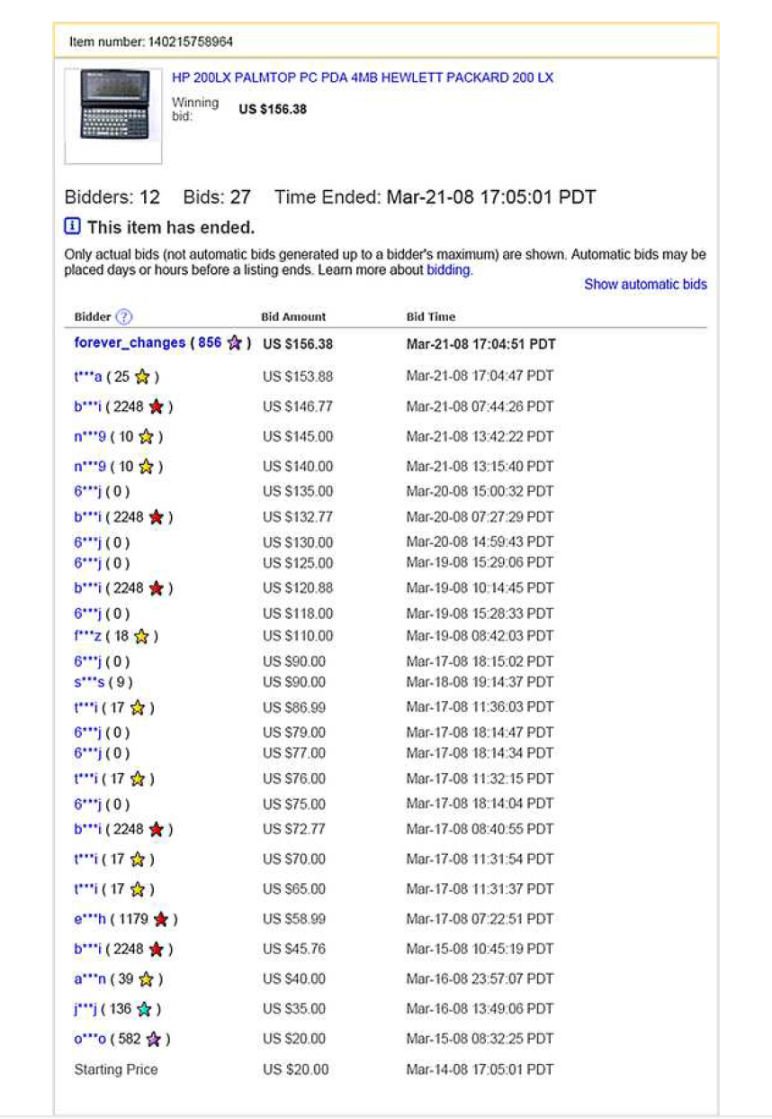
Notes:
This is a screenshot of a seven-day auction history from eBay. Here, there are three variables that we should focus on. This 1st column recorded different names for each bidder, and each time the amount a bidder submit for the item is recorded in the second column. And because the nature of auction, the amount is always monotone increasing until the end of the auction. And the time for each submission is recorded in the third column.

Slide 5
Online Auction Data
Each bidder can submit the maximum amount they are willing to pay (WTP) for the item.
The duration of the auction is pre-determined.
A bidder can place as many bids as desired at any WTP amount and at any time while the auction is in progress.
Online auction data contain series of all WTP amounts and the time at which these were submitted – bidding history.
We are interested in the underlying bidder trajectory
A continuous function that corresponding to a specific realization of a stochastic process.
Will reflect the bidder behavior.
Notes:
So you can imagine each bidder will have a curve consisting a series of WTP amount at each observation point. The curve is just the bid history of a particular bidder for a particular auction. The bidder trajectory can reflects the intentions of a bidder and therefore capture bidder’s behaviors during the auction, and more importantly, this can help us learning about different strategies people used in the auction and one can identify better and worse strategies.

Slide 6
Online Auction Data
Characteristic of online auction data:
Bids are placed sparsely within the time domain of an auction.
Many bidders may submit only very few bids during a given auction.
Timing of bids is irregularly.
Since typical bidder trajectories are observed at only very few and irregular times, this leads to the challenge to define a distance based on sparse and irregular timed data.
Notes:
However, this kind of data have some particular characteristics. In most cases, the beginning and ending of an auction may attract more bidding activities than the middle period. Especially at the end of an auction, people tend to submit more bids due to the desire to win.

Slide 7
Motivation
Our study is motivated by the goal to classify bidder trajectories/strategies based on the observed bidding history.
Challenge: hard to define the distance based on sparse and irregular timed data.
Similar problem also arise in many other types of data
i.e. user reviews and weblog postings
Notes:
Challenge is we cannot simply use the Euclidean distance define the dissimilarity between objects, instead we have to find a different way to define the distance based on sparse and irregular timed data.

Slide 8
Goal
Developed a new method to construct a reasonable distance matrix on the sample space of a stochastic process.
Applied clustering method on the resulting distance matrix.
Identified different bidder trajectories.
Notes:
So the proposed method provides a useful tool and solves the problem to defining a distance when the data are sparse and irregular.
After the distances for such data have been obtained, one can apply clustering methods to classify such data and identified different bidder trajectories.

Slide 9
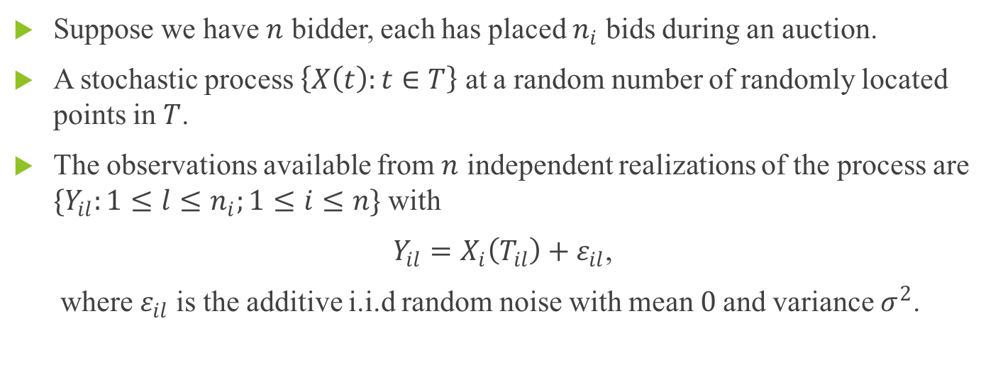
Notations
Suppose we have $n$ bidder, each has placed $n_{i}$ bids during an auction.
A stochastic process $\left\{X\left(t\right):t∈T\right\}$ at a random number of randomly located points in $T$.
The observations available from $n$ independent realizations of the process are $\{Y_{il}:1≤l≤n_{i};1≤i≤n\}$ with
$Y_{il}=X_{i}\left(T_{il}\right)+ε_{il}$,
where $ε_{il}$ is the additive i.i.d random noise with mean $0$and variance $σ^{2}$.
Notes:
So the number of bids submitted by each individual is different and here we define the number of bids the that individual i submitted is ni.
And X(t) is the underlying stochastic process that we are interested.
T is the pre-determined time duration of the auction.
L represents the the number of bids this individual has submitted at the current time.

Slide 10
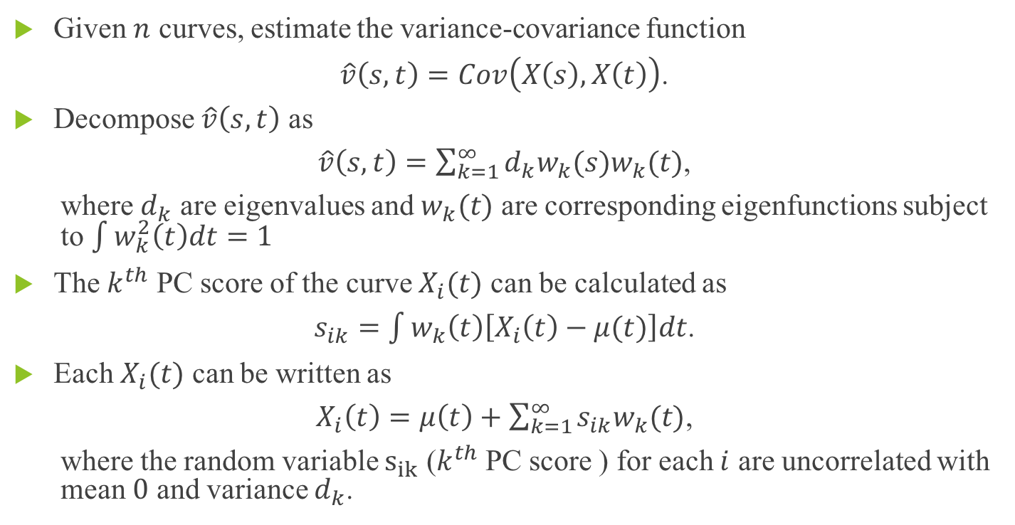
Functional Principal Component Analysis (FPCA)
Given $n$ curves, estimate the variance-covariance function
$\hat{v}\left(s,t\right)=Cov\left(X\left(s\right),X\left(t\right)\right)$.
Decompose $\hat{v}\left(s,t\right)$ as
$\hat{v}\left(s,t\right)=\sum_{k=1}^{∞}{d_{k}w_{k}(s)w_{k}(t)}$,
where $d_{k}$ are eigenvalues and $w_{k}(t)$ are corresponding eigenfunctions subject to $\int{w_{k}^{2}\left(t\right)dt=1}$
The $k^{th}$ PC score of the curve $X_{i}(t)$ can be calculated as
$s_{ik}=\int{w_{k}\left(t\right)\left[X_{i}\left(t\right)−μ(t)\right]dt}$.
Each $X_{i}(t)$ can be written as
$X_{i}\left(t\right)=μ\left(t\right)+\sum_{k=1}^{∞}{s_{ik}w_{k}(t)}$,
where the random variable $s_{ik}$ ($k^{th}$ PC score ) for each $i$ are uncorrelated with mean $0$ and variance $d_{k}$.
Notes:
The first step is to conduct the FPCA on our observed data. I’m pretty sure most of you should be familiar with this method, but I still need to go through this part because the results of FPCA will be used in the following steps.
Sik are uncorrelated with different value of i

Slide 11
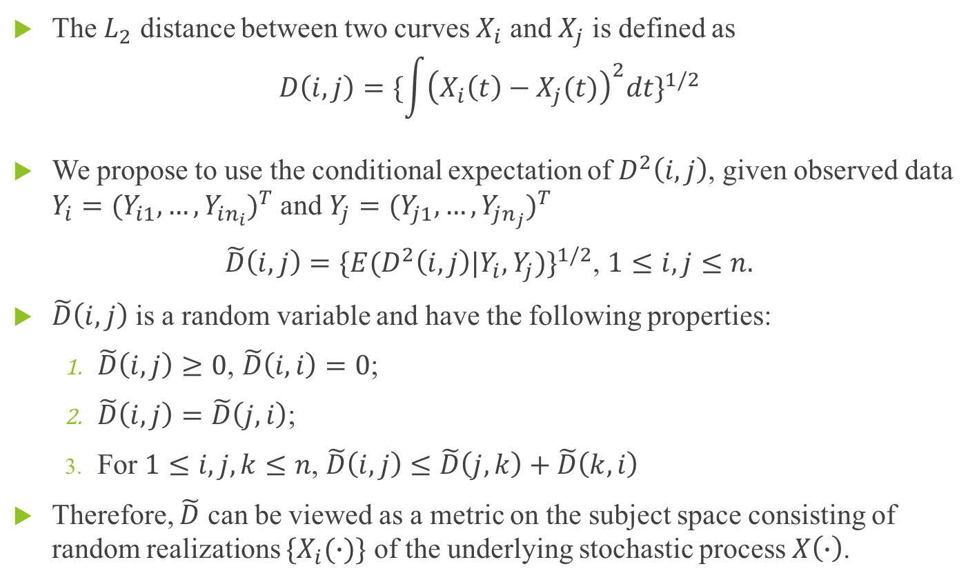
Distance for Sparse and Irregular Data
The $L_{2}$ distance between two curves $X_{i}$ and $X_{j}$ is defined as
$$D\left(i,j\right)={\{\int{{\left(X_{i}\left(t\right)−X_{j}(t)\right)}^{2}dt}\}}^{1/2}$$
We propose to use the conditional expectation of $D^{2}\left(i,j\right)$, given observed data $Y_{i}={(Y_{i1},…,Y_{in_{i}})}^{T}$ and $Y_{j}={(Y_{j1},…,Y_{jn_{j}})}^{T}$
$\tilde{D}\left(i,j\right)={\{E(D^{2}\left(i,j\right)|Y_{i},Y_{j})\}}^{1/2}$, $1≤i, j≤n.$
$\tilde{D}\left(i,j\right)$ is a random variable and have the following properties:
$\tilde{D}\left(i,j\right)≥0\text{,} \tilde{D}\left(i,i\right)=0$;
$\tilde{D}\left(i,j\right)=\tilde{D}\left(j,i\right)$;
For $1≤i, j,k≤n$, $\tilde{D}\left(i,j\right)≤\tilde{D}\left(j,k\right)+\tilde{D}\left(k,i\right)$
Therefore, $\tilde{D}$ can be viewed as a metric on the subject space consisting of random realizations $\{X_{i}(∙)\}$ of the underlying stochastic process $X\left(∙\right)$.
Notes:
This distance is not calculable in our situation, because only the sparse data are observed.
So we proposed a new way to define this distance.

Slide 12
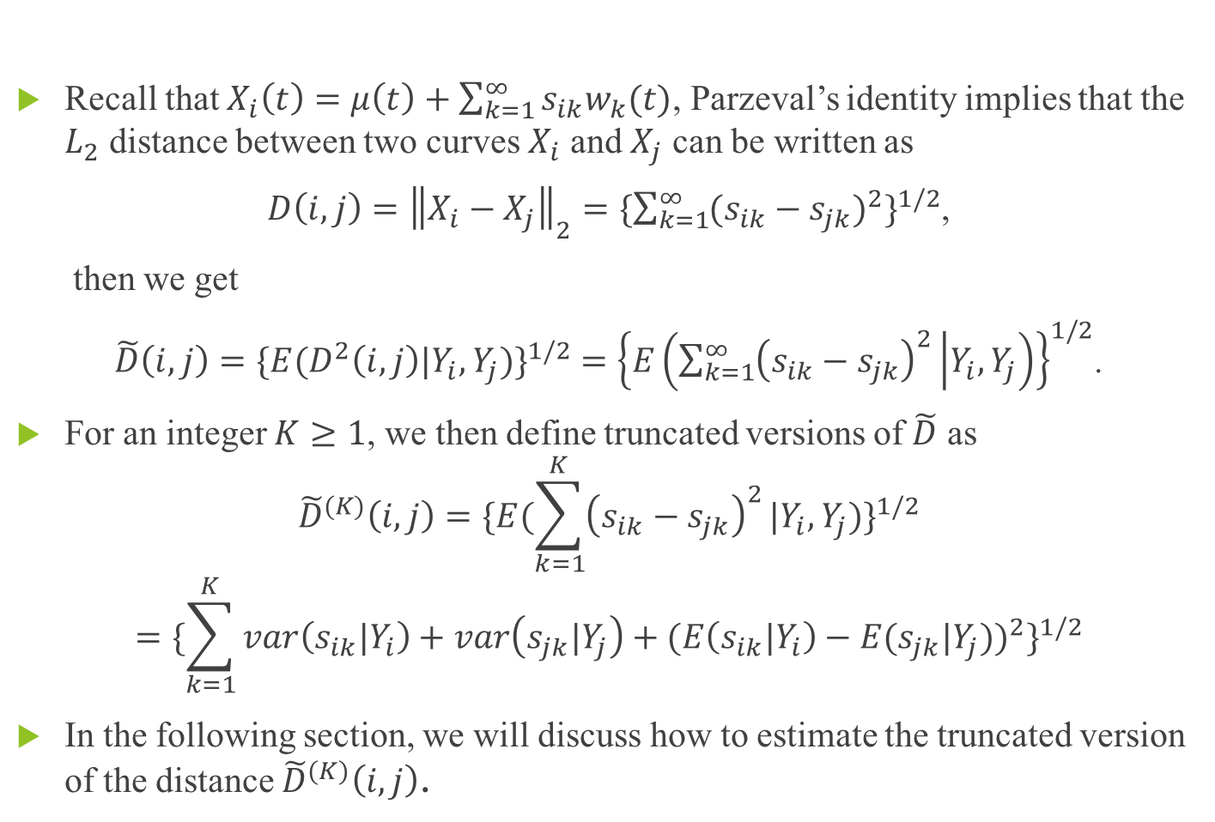
Distance for Sparse and Irregular Data
Recall that $X_{i}\left(t\right)=μ\left(t\right)+\sum_{k=1}^{∞}{s_{ik}w_{k}(t)}$, Parzeval’s identity implies that the $L_{2}$ distance between two curves $X_{i}$ and $X_{j}$ can be written as
$D\left(i,j\right)={\left\|X_{i}−X_{j}\right\|}_{2}={\{\sum_{k=1}^{∞}{{(s_{ik}−s_{jk})}^{2}}\}}^{1/2}$,
then we get
$\tilde{D}\left(i,j\right)={\{E(D^{2}\left(i,j\right)|Y_{i},Y_{j})\}}^{1/2} ={\left\{E\left(\sum_{k=1}^{∞}{{\left(s_{ik}−s_{jk}\right)}^{2}} | Y_{i},Y_{j}\right)\right\}}^{1/2}$.
For an integer $K≥1$, we then define truncated versions of $\tilde{D}$ as
$${\tilde{D}}^{(K)}\left(i,j\right)={\{E(\sum_{k=1}^{K}{{\left(s_{ik}−s_{jk}\right)}^{2}}|Y_{i},Y_{j})\}}^{1/2}$$
$$={\{\sum_{k=1}^{K}{{var\left(s_{ik}|Y_{i}\right)+var\left(s_{jk}|Y_{j}\right)+(E\left(s_{ik}|Y_{i}\right)−E(s_{jk}|Y_{j}))}^{2}}\}}^{1/2}$$
In the following section, we will discuss how to estimate the truncated version of the distance ${\tilde{D}}^{(K)}\left(i,j\right)$.
Notes:
The square root of the sum of the squared difference of PC scores between two curves, given Yi and Yj.
And the term in the square root can be further expanded as

Slide 13
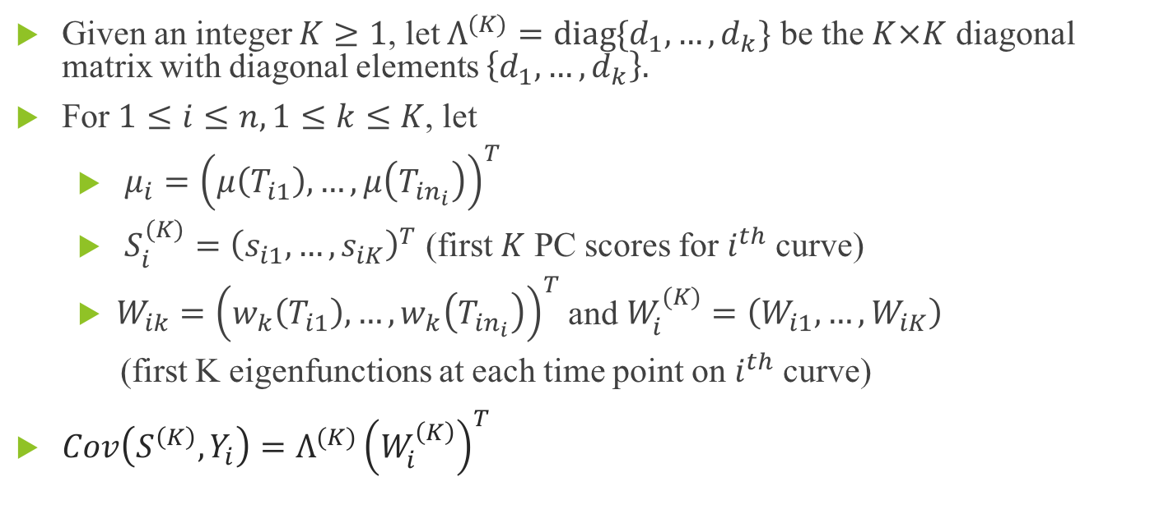
Estimation of the distance metric
Given an integer $K≥1$, let $Λ^{(K)}=diag\{d_{1},…,d_{k}\}$ be the $K×K$ diagonal matrix with diagonal elements $\left\{d_{1},…,d_{k}\right\}.$
For $1≤i≤n, 1≤k≤K$, let
$μ_{i}={\left(μ\left(T_{i1}\right),…,μ\left(T_{in_{i}}\right)\right)}^{T}$
$S_{i}^{(K)}={\left(s_{i1},…,s_{iK}\right)}^{T}$ (first $K$ PC scores for $i^{th}$curve)
$W_{ik}={\left(w_{k}\left(T_{i1}\right),…,w_{k}\left(T_{in_{i}}\right)\right)}^{T}$ and $W_{i}^{(K)}=\left(W_{i1},…,W_{iK}\right)$
(first K eigenfunctions at each time point on $i^{th}$curve)
$Cov\left(S^{\left(K\right)},Y_{i}\right)=Λ^{(K)}{\left(W_{i}^{\left(K\right)}\right)}^{T}$
Notes:
Mu_i is a vector of mean value at each time point for cuve X_i.
S_i(k) is a vector of the first K PC scores for ith curve
Wik is a vector of the value of the kth eigenfunctions at each time point for ith curve, and W_i(K) represents a matrix containing first K eigenfunctions at each time point on $i^{th}$curve. So columns in W_i are wik, with k from1 to K.
I will show you how this equation is derived in the next slide

Slide 14
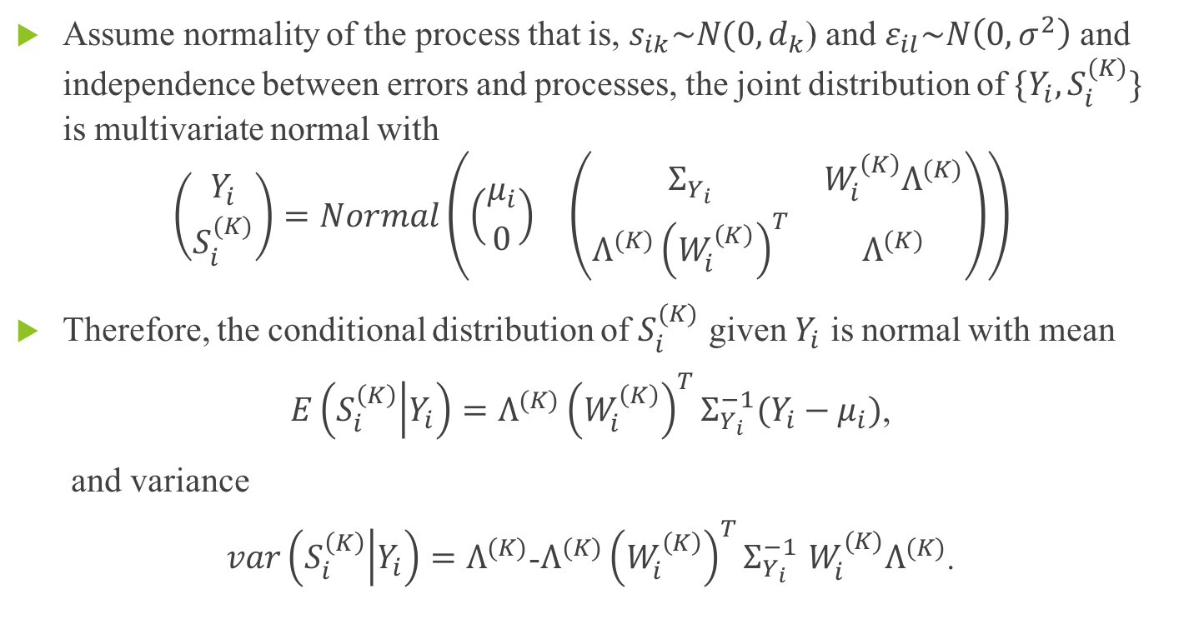
Estimation of the distance metric
Assume normality of the process that is, $s_{ik}\sim N(0,d_{k}$) and $ε_{il}\sim N\left(0,σ^{2}\right)$ and independence between errors and processes, the joint distribution of $\{Y_{i},S_{i}^{(K)}\}$ is multivariate normal with
$$\left({Y_{i} \atop S_{i}^{(K)}}\right)=Normal\left(\begin{matrix}\left({μ_{i} \atop 0}\right) & \left(\begin{matrix}Σ_{Y_{i}} & W_{i}^{\left(K\right)}Λ^{(K)} \\ Λ^{(K)}{\left(W_{i}^{\left(K\right)}\right)}^{T} & Λ^{(K)}\end{matrix}\right)\end{matrix}\right)$$
Therefore, the conditional distribution of $S_{i}^{(K)}$ given $Y_{i}$ is normal with mean
$E\left(S_{i}^{\left(K\right)} | Y_{i}\right)=Λ^{(K)}{\left(W_{i}^{\left(K\right)}\right)}^{T}Σ_{Y_{i}}^{−1}(Y_{i}−μ_{i})$,
and variance
$var\left(S_{i}^{\left(K\right)} | Y_{i}\right)=Λ^{(K)}$-$Λ^{(K)}{\left(W_{i}^{\left(K\right)}\right)}^{T}Σ_{Y_{i}}^{−1}$ $W_{i}^{(K)}Λ^{(K)}$.
Notes:
since sik ~ (0, d_k), then the variance of S_i, which is a vector of sik, is the diagonal matrix Lamdba.

Slide 15
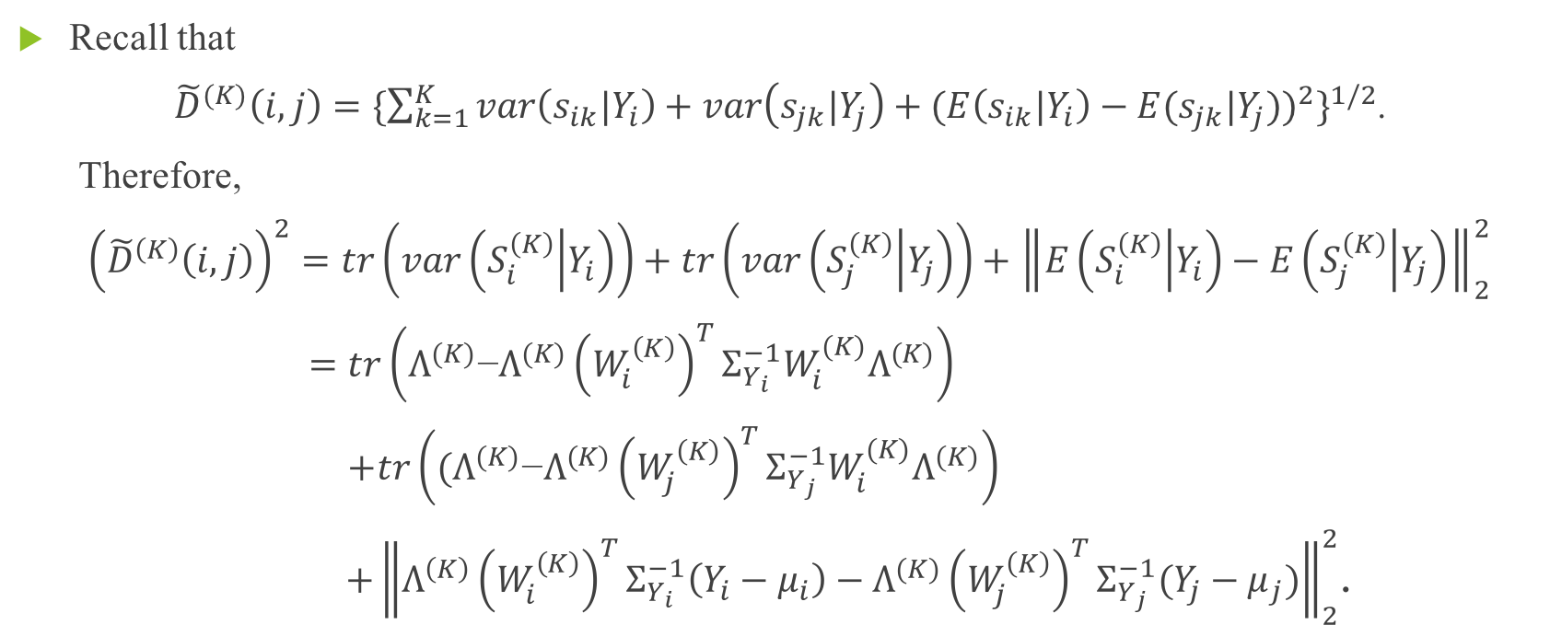
Estimation of the distance metric
Recall that
${\tilde{D}}^{(K)}\left(i,j\right)={\{\sum_{k=1}^{K}{{var\left(s_{ik}|Y_{i}\right)+var\left(s_{jk}|Y_{j}\right)+(E\left(s_{ik}|Y_{i}\right)−E(s_{jk}|Y_{j}))}^{2}}\}}^{1/2}$.
Therefore,
${\left({\tilde{D}}^{\left(K\right)}\left(i,j\right)\right)}^{2}=tr\left(var\left(S_{i}^{\left(K\right)} | Y_{i}\right)\right)+tr\left(var\left(S_{j}^{\left(K\right)} | Y_{j}\right)\right)+{\left\|E\left(S_{i}^{\left(K\right)} | Y_{i}\right)−E\left(S_{j}^{\left(K\right)} | Y_{j}\right)\right\|}_{2}^{2}$
$=tr\left(Λ^{(K)}\text{−}Λ^{(K)}{\left(W_{i}^{\left(K\right)}\right)}^{T}Σ_{Y_{i}}^{−1}W_{i}^{(K)}Λ^{(K)}\right)$
$+tr\left((Λ^{(K)}\text{−}Λ^{(K)}{\left(W_{j}^{\left(K\right)}\right)}^{T}Σ_{Y_{j}}^{−1}W_{i}^{(K)}Λ^{(K)}\right)$
$+{\left\|Λ^{\left(K\right)}{\left(W_{i}^{\left(K\right)}\right)}^{T}Σ_{Y_{i}}^{−1}\left(Y_{i}−μ_{i}\right)−Λ^{(K)}{\left(W_{j}^{\left(K\right)}\right)}^{T}Σ_{Y_{j}}^{−1}(Y_{j}−μ_{j})\right\|}_{2}^{2}$.

Slide 16
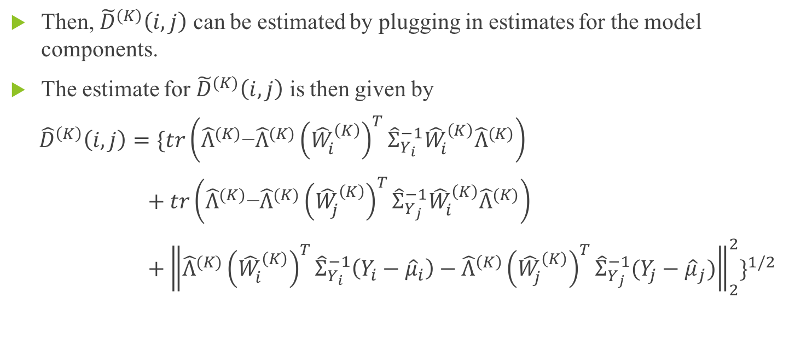
Estimation of the distance metric
Then, ${\tilde{D}}^{(K)}\left(i,j\right)$ can be estimated by plugging in estimates for the model components.
The estimate for ${\tilde{D}}^{(K)}\left(i,j\right)$ is then given by
${\hat{D}}^{\left(K\right)}\left(i,j\right)=\{tr\left({\hat{Λ}}^{(K)}\text{−}{\hat{Λ}}^{(K)}{\left({\hat{W}}_{i}^{\left(K\right)}\right)}^{T}{\hat{Σ}}_{Y_{i}}^{−1}{\hat{W}}_{i}^{\left(K\right)}{\hat{Λ}}^{(K)}\right)$
$+ tr\left({\hat{Λ}}^{(K)}\text{−}{\hat{Λ}}^{(K)}{\left({\hat{W}}_{j}^{\left(K\right)}\right)}^{T}{\hat{Σ}}_{Y_{j}}^{−1}{\hat{W}}_{i}^{\left(K\right)}{\hat{Λ}}^{(K)}\right)$
$+$ ${\left\|{\hat{Λ}}^{(K)}{\left({\hat{W}}_{i}^{\left(K\right)}\right)}^{T}{\hat{Σ}}_{Y_{i}}^{−1}\left(Y_{i}−{\hat{μ}}_{i}\right)−{\hat{Λ}}^{\left(K\right)}{\left({\hat{W}}_{j}^{\left(K\right)}\right)}^{T}{\hat{Σ}}_{Y_{j}}^{−1}(Y_{j}−{\hat{μ}}_{j})\right\|}_{2}^{2}\}^{1/2}$
Notes:
Lambda hat is just the K*K diagonal matrix whose diagonal element is the largest K eignevalues;
W_i hat is a vector containing first K eigenfunctions at each time point on $i^{th}$curve
Mu_i is a vector of mean value at each time point for cuve X_i.

Slide 17
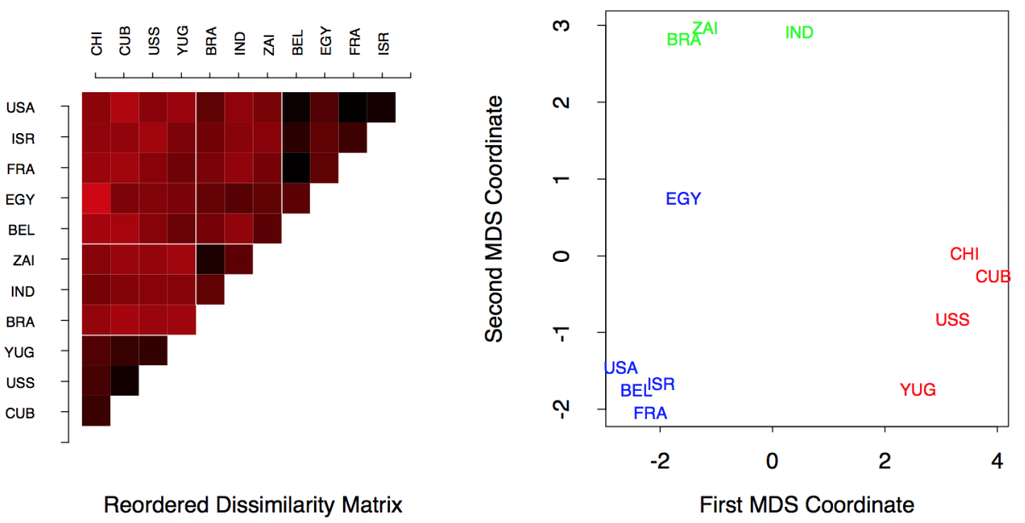
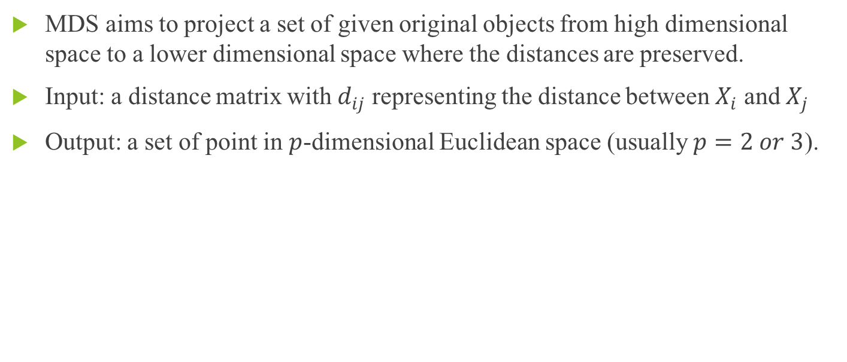
Multidimensional scaling (MDS)
MDS aims to project a set of given original objects from high dimensional space to a lower dimensional space where the distances are preserved.
Input: a distance matrix with $d_{ij}$ representing the distance between $X_{i}$ and $X_{j}$
Output: a set of point in $p$-dimensional Euclidean space (usually $p=2 or 3$).
Notes:
MDS is a method for dimension reduction, it aims to reconstruct a map with lower dimensional space, but at the same time will preserve the pairwise distances between objects in the original data. So MDS addresses the problem of constructing a configuration of points in Euclidean space by using information about the distances between the original objects, according to some target criterion.
This graph gives a good example of how does MDS work. In the left panel, it is something like a heatmap representing the measuring distance between each two objects. The smaller the distance is between two objects, the darker the color will be presented in the graph.
The projected points in this low dimensional space represent the original objects in such a way that their distances match with the original distances.

Slide 18
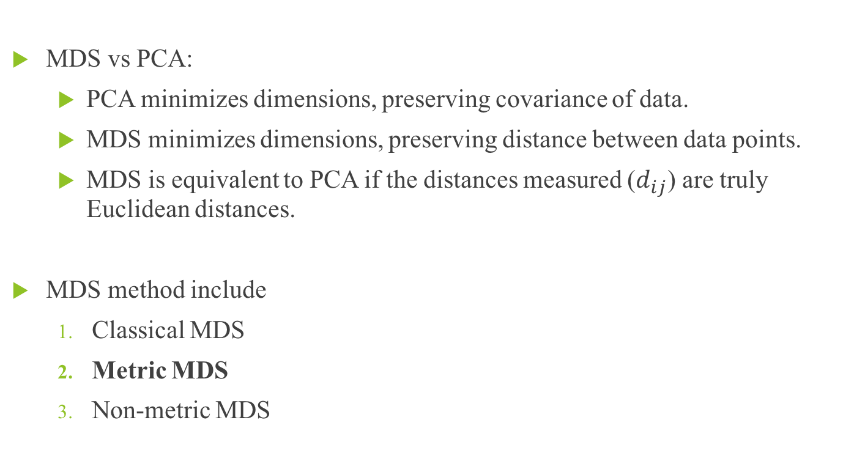
Multidimensional scaling (MDS)
MDS vs PCA:
PCA minimizes dimensions, preserving covariance of data.
MDS minimizes dimensions, preserving distance between data points.
MDS is equivalent to PCA if the distances measured ($d_{ij}$) are truly Euclidean distances.
MDS method include
Classical MDS
Metric MDS
Non-metric MDS
Notes:
PCA and MDS are both dimensionality reduction methods, but they optimize for different things.
PCA: data are projected onto the directions in the data with the most variance. Hence the “spread” of the data is roughly conserved as the dimensionality decrease.
MDS: The input to MDS is the pairwise distances between points and the output is a 2/3-dimensional projection of the points where distances are preserved.
The method used in the paper is metric MDS, so I will only focus on metric MDS in the following slides.

Slide 19
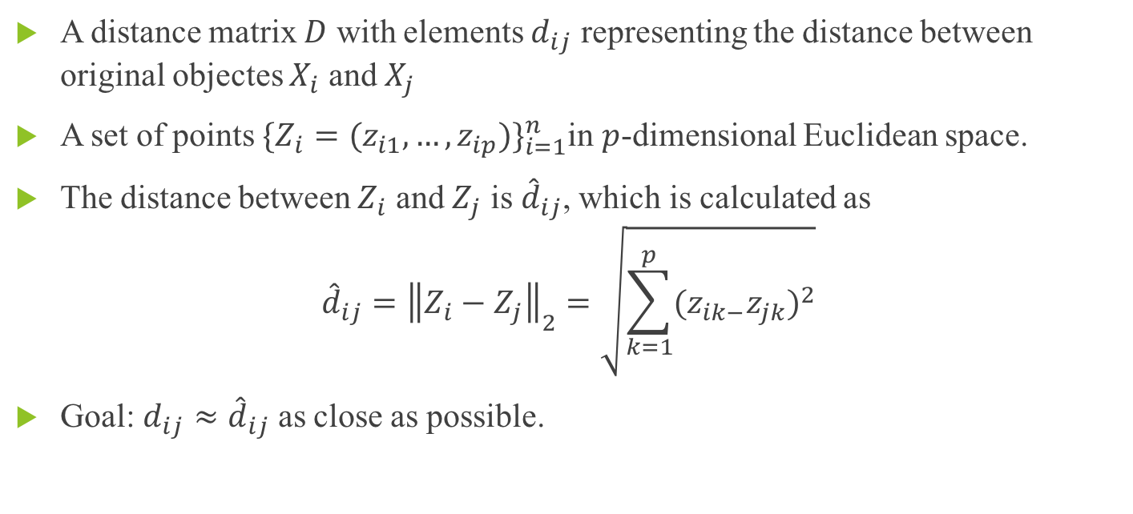
Metric MDS
A distance matrix $D$ with elements $d_{ij}$ representing the distance between original objectes $X_{i}$ and $X_{j}$
A set of points ${\{Z_{i}=(z_{i1},…,z_{ip})\}}_{i=1}^{n}$in $p$-dimensional Euclidean space.
The distance between $Z_{i}$ and $Z_{j}$ is ${\hat{d}}_{ij}$, which is calculated as
$${\hat{d}}_{ij}={\left\|Z_{i}−Z_{j}\right\|}_{2}=\sqrt{\sum_{k=1}^{p}{{(z_{ik−}z_{jk})}^{2}}}$$
Goal: $d_{ij}≈{\hat{d}}_{ij}$ as close as possible.
Notes:
Our goal is to make dij hat as close as possible to dij for each pair of i,j.

Slide 20
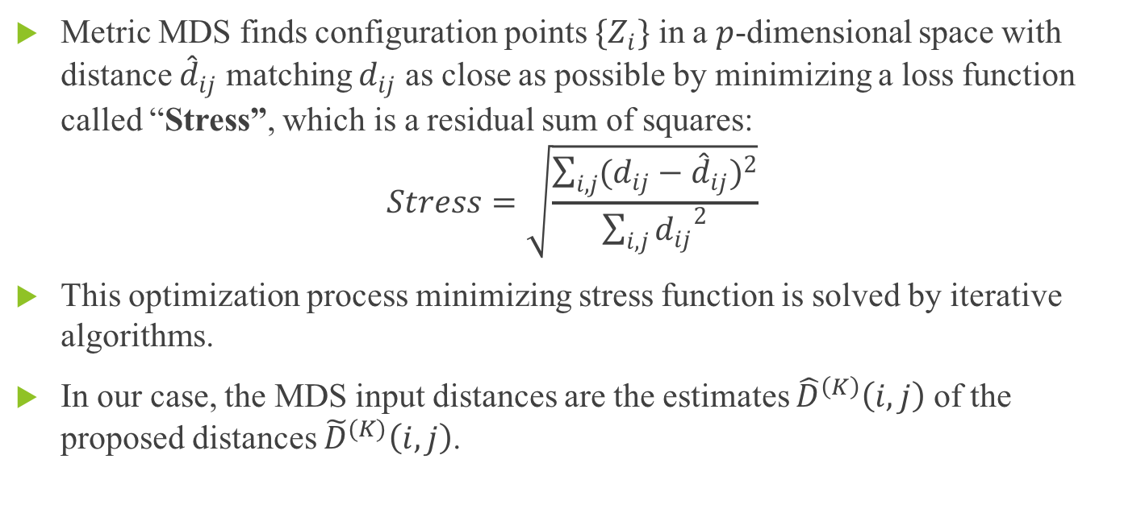
Metric MDS
Metric MDS finds configuration points $\{Z_{i}\}$ in a $p$-dimensional space with distance ${\hat{d}}_{ij}$ matching $d_{ij}$ as close as possible by minimizing a loss function called “Stress”, which is a residual sum of squares:
$$Stress=\sqrt{\frac{\sum_{i,j}{{(d_{ij}−{\hat{d}}_{ij})}^{2}}}{\sum_{i,j}{{d_{ij}}^{2}}}}$$
This optimization process minimizing stress function is solved by iterative algorithms.
In our case, the MDS input distances are the estimates ${\hat{D}}^{\left(K\right)}\left(i,j\right)$ of the proposed distances ${\tilde{D}}^{(K)}\left(i,j\right)$.

Slide 21
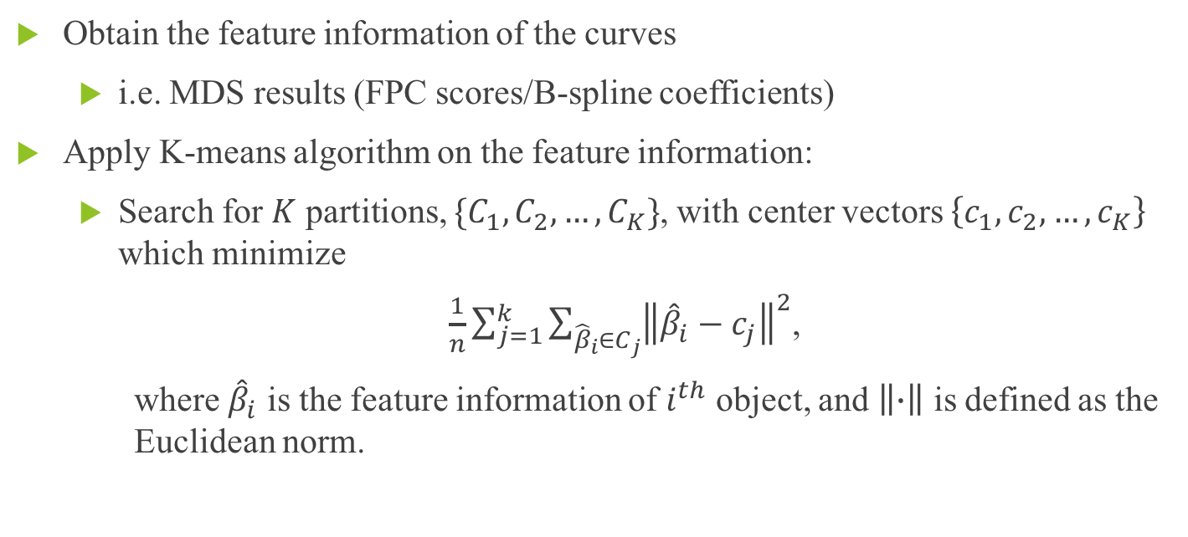
K-means clustering method
Obtain the feature information of the curves
i.e. MDS results (FPC scores/B-spline coefficients)
Apply K-means algorithm on the feature information:
Search for $K$ partitions, $\{C_{1},C_{2},…,C_{K}\}$, with center vectors $\left\{c_{1},c_{2},…,c_{K}\right\}$ which minimize
$\frac{1}{n}\sum_{j=1}^{k}{\sum_{{\hat{β}}_{i}∈C_{j}}{{\left\|{\hat{β}}_{i}−c_{j}\right\|}^{2}}}$,
where ${\hat{β}}_{i}$ is the feature information of $i^{th}$ object, and $\left\|∙\right\|$ is defined as the Euclidean norm.
Notes:
The next step is we are going to apply the K-means clustering method once we have the MDS results. K-means clustering method is applied on the some feature information of the curves. In our case, the MDS results were viewed as the feature information of the curves and we will apply the K-means clustering method on the MDS result; but in other cases, it can also be applied on FPC scores/B-spline coefficients.
The key idea of K-means algorithm is we are going to search …
The K cluster and the center vector have to be chosen in way that the sum of the distances of points in a cluster to the corresponding center vector is minimized for each cluster.
Beta is the MDS result for ith curve, which is a point on p-dimensional space, in other words, it is a vector with p-dimensions.

Slide 22
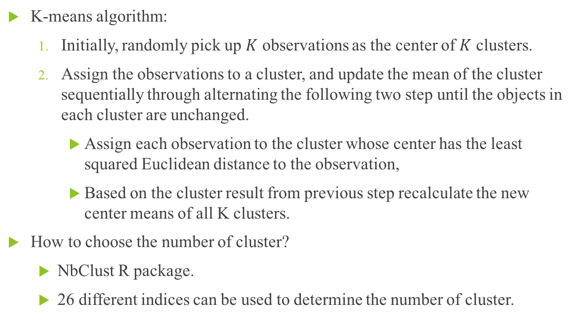
K-means clustering method
K-means algorithm:
Initially, randomly pick up $K$ observations as the center of $K$ clusters.
Assign the observations to a cluster, and update the mean of the cluster sequentially through alternating the following two step until the objects in each cluster are unchanged.
Assign each observation to the cluster whose center has the least squared Euclidean distance to the observation,
Based on the cluster result from previous step recalculate the new center means of all K clusters.
How to choose the number of cluster?
NbClust R package.
26 different indices can be used to determine the number of cluster.
Notes:
The K-means algorithm consists of 2 major steps.

Slide 23
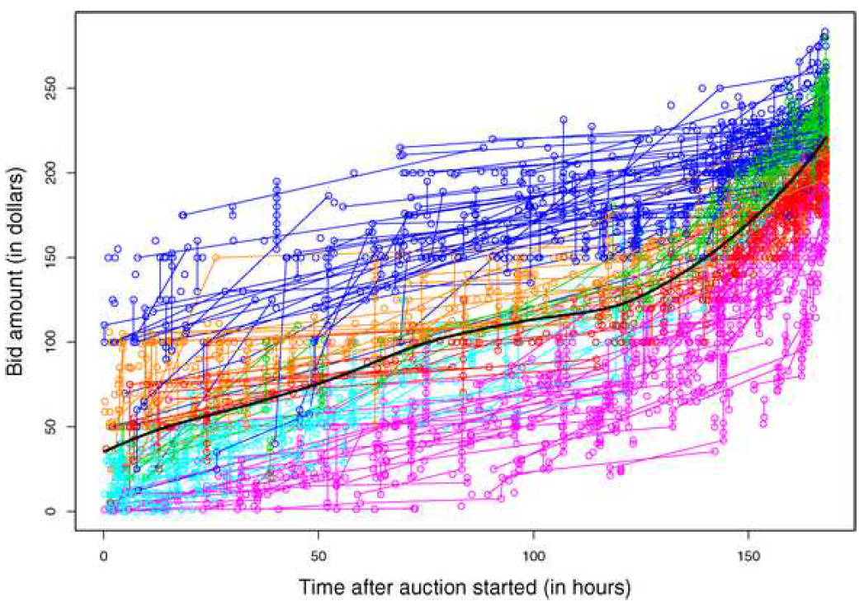
Dataset overview
eBay online auction data for 158 seven-day auctions.
These data contain recorded bids and their respective times as well as WTP amount for 1122 distinct bidders with 1801 different bidder trajectories.
Notes:
This is a overview of the dataset used in the paper.
The reason why the # of bidder trajectories is greater than the # of bidder is that one bidder can generate a bidder trajectory in several different auctions and one auction usually consists of several bidder trajectories by several different bidders.
This graph shows what the data looks like. The curves are labeled by different colors based on what clusters they are belonging to. And later on, I will show you the specific pattern of each cluster.

Slide 24
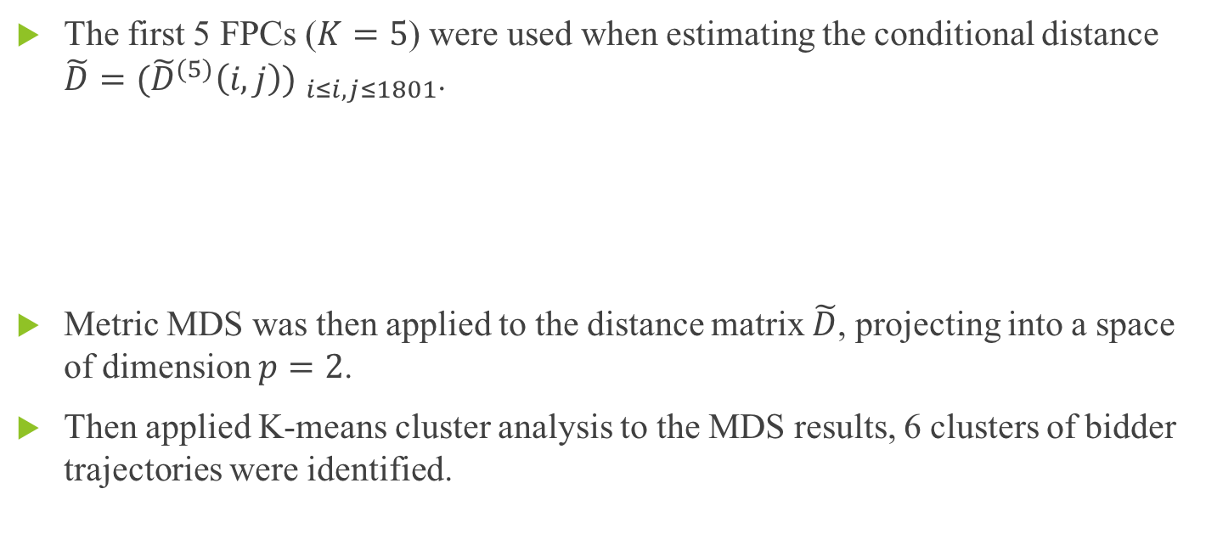
Method overview
The first 5 FPCs ($K=5$) were used when estimating the conditional distance $\tilde{D}={({\tilde{D}}^{(5)}\left(i,j\right)) }_{i≤i,j≤1801}$.
Metric MDS was then applied to the distance matrix $\tilde{D}$, projecting into a space of dimension $p=2$.
Then applied K-means cluster analysis to the MDS results, 6 clusters of bidder trajectories were identified.
PC1 | PC2 | PC3 | PC4 | PC5 | Total
78.6% | 12.6% | 2.21% | 1.72% | 0.87% | 96%

Slide 25
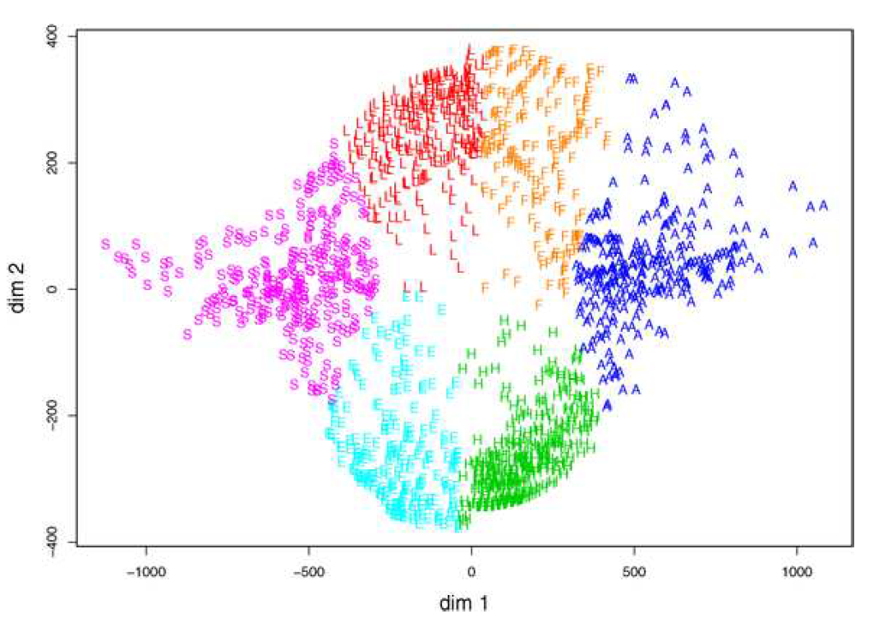
Clustering results
Clusters were labeled as “L” (Low end), “H” (High end), “S”(Slow start), “F”(Fast start), “A”(Aggressive) and “E”(Early).
Notes:
So this graph shows the MDS results when the original distances that were measured using the proposed method are projected to a 2-dimensional space. Also the points is labeled according to the K-means clustering results.
So six clusters are labeled as ….
Each label describes a particular pattern of the bidding behaviors for this cluster.

Slide 26
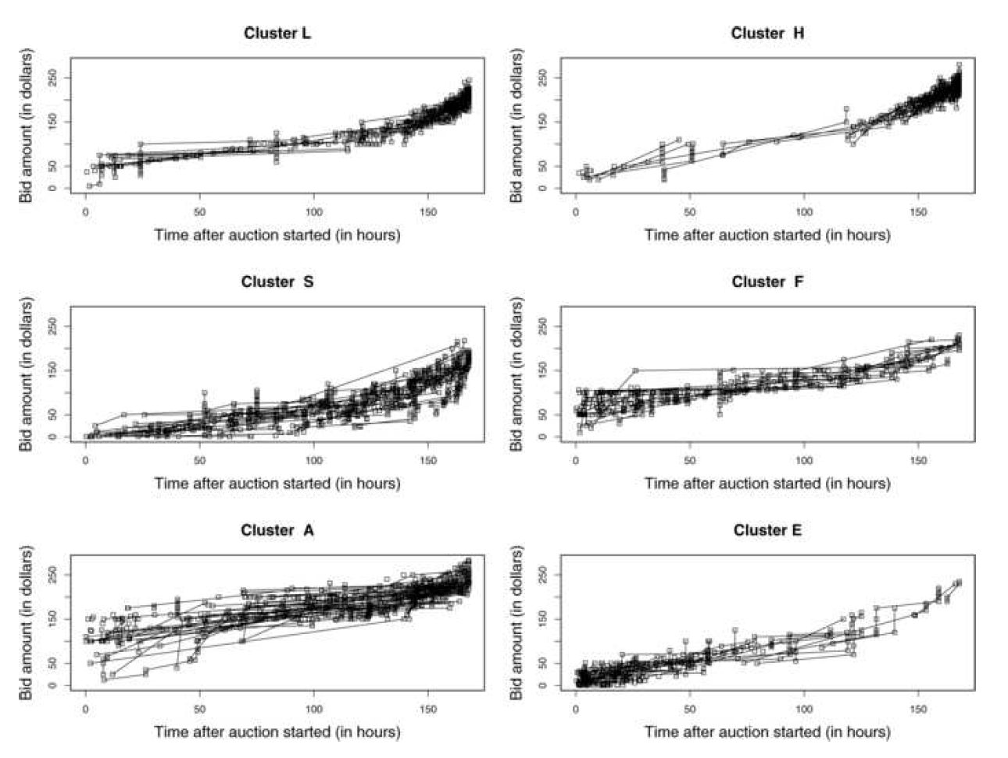
Notes:
From this graph, we can bidder behaviors fall into 6 distinct clusters, each associated with specific characteristics of the corresponding bidders trajectories.
For example, the cluster which labelled as “S” mean “slow start”, so the bidders in cluster S tend to slowly raise their bids at the beginning and then increase them faster toward the end of the auction.
And the cluster which labelled as “E” means “Early”, so the bidders in cluster E tend to submit low bids at the beginning of the auction, and then reduce number of bids submitted in the rest of the time.
This is not too surprising that the cluster H will have the highest winner rate because the bidders in cluster H tend to place high bids near the end of the auction. So actually they have more change to win the item in the end.
Cluster A also have high winning rate because its bidders tend to place high bids throughout the entire auction.

Slide 27
Insights from the results
It is instructive to study the winning rate and the average prices paid when winning the bid for each cluster.
Winning rate = the fraction of bidders in the cluster winning the auction
It turns out that the 6 bidding trajectories can be clearly distinguished in terms of how well the they achieve their goals.
Cluster | H | A | L | S | E | F
Winning rate | 24.3% | 9.1% | 7.5% | 0.67% | 0.45% | 0%
Average prices paid | 237$ | 245$ | 208$ | 177$ | 230$ | NA
Notes:
But the chance of winning is very small for the remaining three groups, cluster S and E only have 2 and 1 winners respectively, and there is no winner in cluster F.
Winners in cluster A pay highest with 245, while winners in H pay slightly less, and winners in L pay considerably less.
However, can we conclude that the “H” is the best bidding strategy? The answer depends on your goal. If you goal is to win the item, than H seems to be the best strategies, but if the goal it to win the item with a lower price and a reasonable chance, then L maybe the best strategy.

Slide 28
Summary
The propose methodology is generally useful for longitudinal studies where clustering of subjects is of interest and data are sparse and irregular.
The proposed functional distance is defined conditionally on observed data of the underlying trajectories.
Once the distances for such data have been obtained, besides MDS and K-means clustering, many different statistical tools can be applied to classify such data.
Appling this proposed method on online auction data reveals some interesting features of each particular bidding strategies.
Notes:
Applying this proposed method on online auction data gives us insights on bidding strategies.
We can see there are some interactions between the timing of bids, the amount paid and the actual winning rate.

Slide 29
Thanks for listening!

